Slide 1
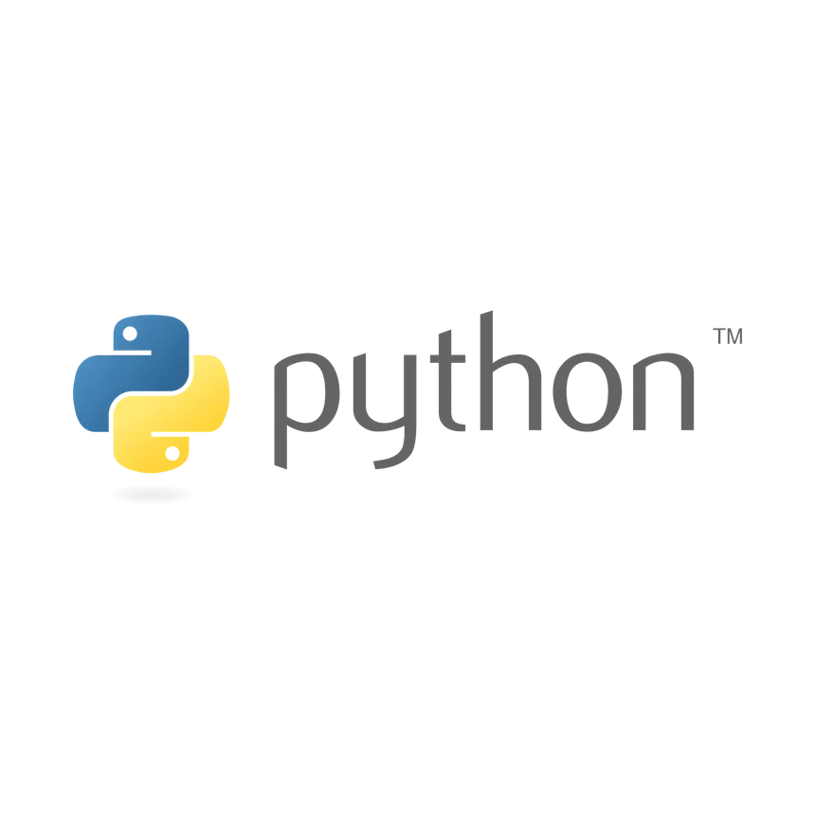

Slide 2








Programming
+977 9846871406
shrestha.baburam1997@gmail.com
https://www.linkedin.com/in/shrestha-baburam/
https://github.com/baburam1997/

Slide 3
Python Programming
by
Er. Baburam Shrestha﻿
Data Engineer at Fusemachine Nepal
Perusing ME-Computer in Everest Engineering College(Pokhara University)
BE-Computer Graduate From Everest Engineering College(Pokhara University)
+977 9846871406
shrestha.baburam1997@gmail.com
https://www.linkedin.com/in/shrestha-baburam/
https://github.com/baburam1997/

Slide 4
Python Programming Language
High-Level Language
Interpreted and Interactive
Versatile and Multi-Paradigm
Extensive Standard Library
Community and Ecosystem

Slide 5
Python Interpreter
Dynamic Typing
Readability and Simplicity
Portability
Interactive Development
Ease of Debugging

Slide 6
Installation of Python Interpreter
All OS: https://python.land/installing-python
In Window OS: https://www.python.org/downloads/windows/
In Linux OS: https://www.python.org/download/other/
In Mac OS: https://www.python.org/downloads/macos/
For Windows:
  Go to the python official website (python.org.)
  Click on the "Downloads" tab. And download the latest version.
  After completing run the installer. Make sure to check the box that says "Add Python x.x to PATH" during installation. This makes it easier to run Python from the command prompt.
  Type “python --version” at the command prompt or powershell to check the version.
If python path is not found in your system then visit: https://www.geeksforgeeks.org/how-to-add-python-to-windows-path/

Slide 7
Python: Command Prompt/Terminal
Open Terminal/Command Terminal
Play with basic python commands
print("Hello There! It is Python Programming.")
# Python Programming do not need main function to execute the program.
"""
Python Programming
do not need main function
to execute the program
"""
'''
Python Programming
do not need main function
to execute the program
'''

Slide 8
Features of Python
Python is commonly used for developing websites and software, task automation, data analysis, and data visualization.
Open Source
Cross-Platform
High-Level Language
Object-Oriented Programming (OOP)
Dynamically Typed
Easy to read
Interpreted
Extensive Standard Library

Slide 9
Pros of Python
Readability
Versatility
Extensive Standard Library
Community and Ecosystem
Platform Independence

Slide 10
Cons of Python
Performance
Runtime Errors
Memory Consumption
Global Interpreter Lock (GIL): Python is Global Interpreter Lock can limit multi-threaded performance in CPU-bound applications by allowing only one thread to execute Python bytecode at a time, although it does not significantly affect I/O-bound or asynchronous applications.

Slide 11
Application and Scope of Python
Web Development: Django, Flask
Data Science and Machine Learning: NumPy, Pandas, and TensorFlow
Scripting and Automation: System administration, batch processing, and task automation
Desktop GUI Applications: Tkinter, PyQt, or PyGTK
Scientific Computing: SciPy, Matplotlib, and Jupyter

Slide 12
History of Python
Python was invented by Guido van Rossum in 1991 at CWI in Netherland.
The idea of Python programming language has taken from the ABC programming language or we can say that ABC is a predecessor of Python language.
There is also a fact behind the choosing name Python. Guido van Rossum was a fan of the popular BBC comedy show of that time, "Monty Python's Flying Circus". So he decided to pick the name Python for his newly created programming language.
Python has the vast community across the world and releases its version within the short period.

Slide 13
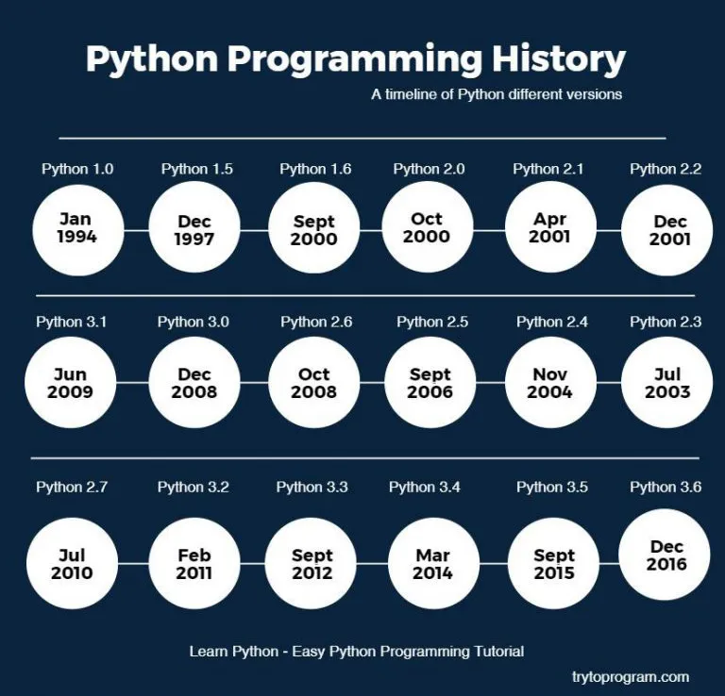
History of Python

Slide 14
Setting Environment for Python and Jupyter
Installing/ Creating a virtual Environment
$ pip install virtualenv
$ virtualenv --version
$ python -m venv myenv
$ myenv\Scripts\activate
$ deactivate
Installing Jupyter Notebook
$ pip install jupyter

Slide 15
Input in Python
Python provides the input() function to read input from the user via the keyboard.
Syntax:
  input(prompt)
Example:
name = input("Enter your name: ")
print("Hello, " + name)

Slide 16
Output in Python
Python print() function is used to output text or data to the console.
Syntax:
  print(object(s), sep=' ', end='\n', file=sys.stdout, flush=False)
Example:
print("Hello There! It is Python Programming.")

Slide 17
Print Function in Python
The print() function displays the given object to the standard output device (screen).
Python print() function is most unique and versatile function.
The syntax of print() function is given below.
print(*objects, sep=' ', end='\n', file=sys.stdout, flush=False)
  objects - An object is nothing but a statement that to be printed. The * sign represents that there can be multiple statements.
  sep - The sep parameter separates the print values. Default values is ' '.
  end - The end is printed at last in the statement.
  file - It must be an object with a write(string) method.
  flush - The stream or file is forcibly flushed if it is true. By default, its value is false

Slide 18
Output Formatting in Python
str.format() Method:
  The str.format() method allows you to format strings using placeholders {} and positional or keyword arguments.
Example:
name = "Alice"
age = 30
print("My name is {} and I am {} years old.".format(name, age))

Slide 19
Output Formatting in Python
Formatted String Literals (f-strings):
Introduced in Python 3.6, f-strings provide a concise and readable way to format strings by embedding expressions inside curly braces {}.
Example:
name = "Alice"
age = 30
print("My name is {name} and I am {age} years old.")

Slide 20
Indentation in Python
Python indentation defines the particular group of statements belongs to the particular blocks.
Indentation is four white space or one tab.
def add(a, b):
print(f"Adding {a} and {b}")
return a + b
result = add(3, 5)
print(f"Result: {result}")

Slide 21
Comment in Python
Comments are essential for defining the code and help us and other to understand the code. By looking the comment, we can easily understand the intention of every line that we have written in code. We can also find the error very easily, fix them, and use in other applications.
We use # symbol to comment in python.
  # Python Programming do not need main function to execute the program.
  """
  Python Programming
  do not need main function to execute the program
  """
  '''
  Python Programming
  do not need main function to execute the program
  '''

Slide 22
Script mode in Python
Execution of Code: Python code is written in a file with a .py extension and is executed all at once.
Efficiency for Larger Programs: Script mode is more efficient for running larger programs since it allows you to write and organize complex code in files, which can be executed as a whole.
Reusability: Python scripts can be saved, reused, and shared. Once a script is written and debugged, it can be run multiple times without needing to re-enter the code, making it a great tool for automation and repetitive tasks.
Command Line Execution: To run a Python script, you typically use the command line or terminal.

Slide 23
Script mode in Python
Advantages of the script mode.
We can run multiple lines of code.
Debugging is easy in script mode.
It is appropriate for beginners and also for experts.
Disadvantages of the script mode.
We have to save the code every time if we make any change in the code.
It can be tedious when we run a single or a few lines of code.

Slide 24
Token in Python
The tokens can be defined as a punctuation mark, reserved words, and each word in a statement.
The token is the smallest unit inside the given program.
There are following tokens in Python:
  Keywords
  Identifiers
  Literals
  Operators

Slide 25
Keywords in Python
Keyword is a reserved word that has a specific meaning in the language and cannot be used as an identifier (such as a variable name, function name, or any other identifier).
Keywords define the syntax and structure of Python programming and are used to represent core concepts like loops, conditionals, or data types.
True | False | None | and | as
asset | def | class | continue | break
else | finally | elif | del | except
global | for | if | from | import
raise | try | or | return | pass
nonlocal | in | not | is | lambda

Slide 26
Keywords in Python
import keyword
print(keyword.kwlist)
"""
['False', 'None', 'True', 'and', 'as', 'assert', 'async', 'await', 'break', 'class', 'continue', 'def', 'del', 'elif', 'else', 'except', 'finally', 'for', 'from', 'global', 'if', 'import', 'in', 'is', 'lambda', 'nonlocal', 'not', 'or', 'pass', 'raise', 'return', 'try', 'while', 'with', 'yield']
"""

Slide 27
Identifier in Python
An identifier is a name used to identify a variable, function, class, module, or other object.
Identifiers are important in Python because they allow you to label data and functions in your code so that they can be referenced and used later.

Slide 28
Variables in Python
Rules for Naming variables:
Allowed Characters: variables can consist of letters (a-z, A-Z), digits (0-9), and underscores (_). They must start with a letter or an underscore.
  Valid examples: my_variable, ClassName, _private_var, var2
  Invalid examples: 2ndVar (cannot start with a digit), my-var (hyphens are not allowed)
Case Sensitivity: Identifiers are case-sensitive, meaning myVar and myvar are considered different identifiers.
Cannot Use Keywords: Python keywords (like if, for, while, class, etc.) cannot be used as identifiers, as they are reserved for specific syntax in the language.
No Special Characters: Special characters like !, @, #, $, etc., are not allowed in identifiers.

Slide 29
Variables in Python
Local Variable
Local variables are the variables that declared inside the function and have scope within the function.
Global Variables
Global variables can be used throughout the program, and its scope is in the entire program.
We can use global variables inside or outside the function
A variable declared outside the function is the global variable by default.
Python provides the global keyword to use global variable inside the function.
global global_variable

Slide 30
Variables in Python
Variable is a name that is used to refer to memory location. Python variable is also known as an identifier and used to hold value.
Examples:
  x = 10 # x is an integer
  z = 10.0 # z is an float
  y = "Hello" # y is a string

Slide 31
Casing in Python
The multi-word keywords can be created by the following method.
Camel Case - In the camel case, each word or abbreviation in the middle of begins with a capital letter. There is no intervention of whitespace. For example - nameOfStudent, valueOfVaraible, etc.
Pascal Case - It is the same as the Camel Case, but here the first word is also capital. For example - NameOfStudent, etc.
Snake Case - In the snake case, Words are separated by the underscore. For example - name_of_student, etc.

Slide 32
Multiple Assignment in Python
Python allows us to assign a value to multiple variables in a single statement, which is also known as multiple assignments.
1. Assigning single value to multiple variables
x=y=z=50
print(x)
2. Assigning multiple values to multiple variables
a,b,c=5,10,15
print( a,b,c)

Slide 33
Data Types in Python
Python Data Types are essential components of Python programming, as they determine the type of data a variable can hold and the operations that can be performed on that data.
Classification of Data types:
  Numeric Data Types:
    int: Represents integer numbers (e.g., 1, 10, -20).
    float: Represents floating-point numbers (e.g., 3.14, 0.0, -2.5).
    complex: Represents complex numbers (e.g., 2+3j, 1j, -5j).
  Textual Data Type:
    str: Represents string data, which are sequences of Unicode characters enclosed in single (') or double (") quotes (e.g., ‘Hello’, “World!”).
  Boolean Data Type:
    bool: Represents boolean values, either True or False.

Slide 34
Data Types in Python
Classification of Data types:
  Collection Data Types:
    list: Represents an ordered, mutable collection of elements, enclosed in square brackets. E.g., [1, 2, 3, 4]
    tuple: Represents an ordered, immutable collection of elements, enclosed in parentheses. E.g., (1, 2, 3, 4)
    dict: Represents an unordered collection of key-value pairs, enclosed in curly braces. E.g., {‘name’: ‘John’, ‘age’: 30}
    set: Represents an unordered collection of unique elements, enclosed in curly braces or created using the set() function
E.g., {1, 2, 3, 4}
    frozenset: Represents an immutable version of the set data type, created using the frozenset() function.
E.g., frozenset({1, 2, 3, 4})

Slide 35
Literals in Python
A literal is a fixed value that is directly written in the code.
These are the most basic elements of a program and represent specific values.
Python supports several types of literals:
  String Literals
  Numeric Literals
  Boolean Literals
  Special Literal
  Collection Literals
  Literal Collections

Slide 36
Literals in Python
String Literals
  String literals are sequences of characters enclosed in single quotes ('...'), double quotes ("..."), triple single quotes ('''...'''), or triple double quotes ("""...""").
  Examples:
    'Hello, World!'
    "Python is awesome!"
    '''This is a multi-line string'''

Slide 37
Literals in Python
Numeric Literals
  Integer Literals: Represent whole numbers without a fractional part.
    Examples: 10, -5, 0
  Floating-Point Literals: Represent numbers with a fractional part, or in exponential form.
    Examples: 3.14, -0.001, 1.5e2 (which is 150.0)
  Complex Literals: Represent complex numbers with a real part and an imaginary part.
    Examples: 3 + 4j, -1j

Slide 38
Literals in Python
Boolean Literals
  Boolean literals represent one of two truth values: True or False.
  Examples:
  is_active = True
  is_logged_in = False
Special Literal
  Python has a special literal, None, which represents the absence of a value or a null value.
  Example:
  result = None

Slide 39
Literals in Python
Collection Literals
  Python has several built-in collection types that can be initialized using literals:
  List Literals: [1, 2, 3], ["apple", "banana", "cherry"]
  Tuple Literals: (1, 2, 3), ("a", "b", "c")
  Dictionary Literals: {"key1": "value1", "key2": "value2"}
  Set Literals: {1, 2, 3}, {"apple", "banana", "cherry"}
Literal Collections
  List: [1, 2, 3], [‘a’, ‘b’, ‘c’]
  Tuple: (1, 2, 3), (‘a’, ‘b’, ‘c’)
  Set: {1, 2, 3}, {‘a’, ‘b’, ‘c’}
  Dictionary: {'name': 'Alice', 'age': 25}

Slide 40
Operators in Python
The operator can be defined as a symbol which is responsible for a particular operation between two operands.
Operators are the pillars of a program on which the logic is built in a specific programming language.
  Arithmetic operators
  Comparison operators
  Assignment Operators
  Logical Operators
  Bitwise Operators
  Membership Operators
  Identity Operators

Slide 41
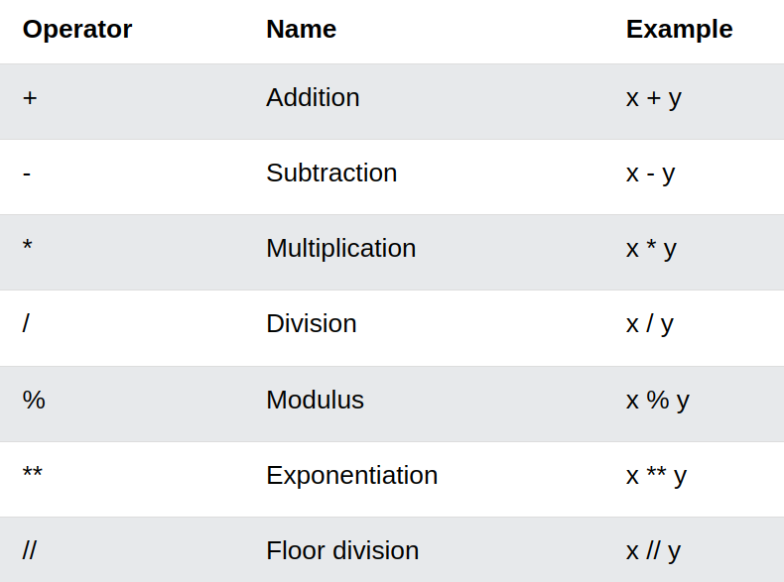
Arithmetic Operators

Slide 42
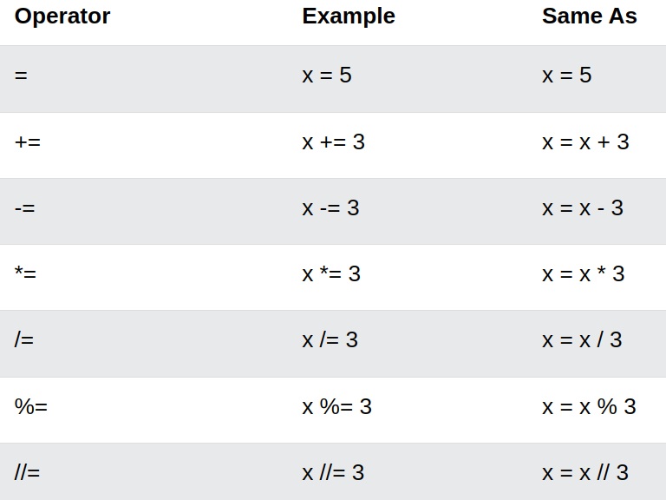
Assignment Operators

Slide 43
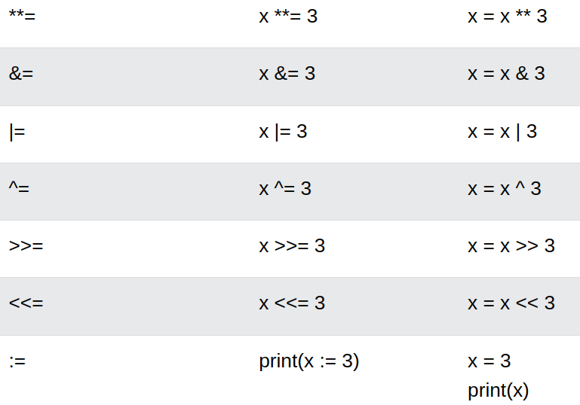
Assignment Operators

Slide 44
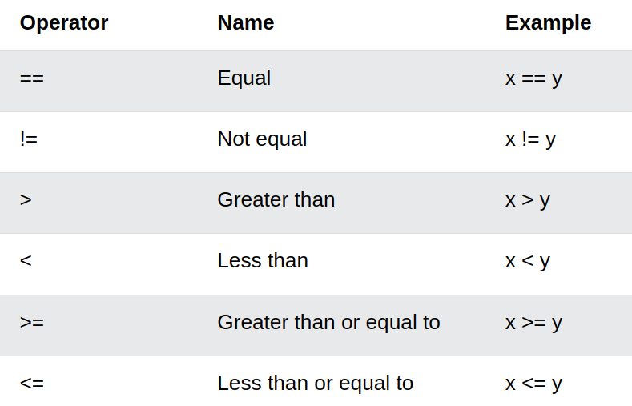
Comparison Operators

Slide 45
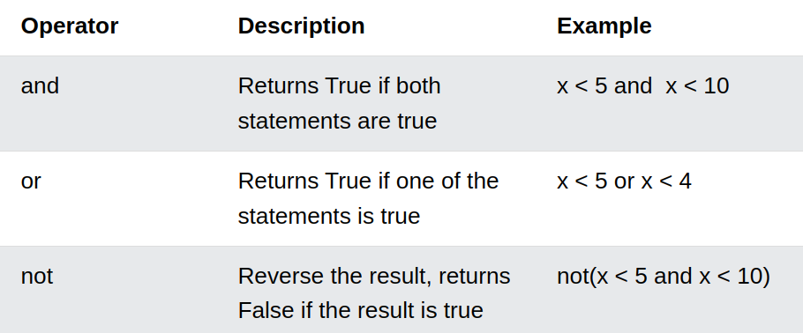
Logical Operators

Slide 46
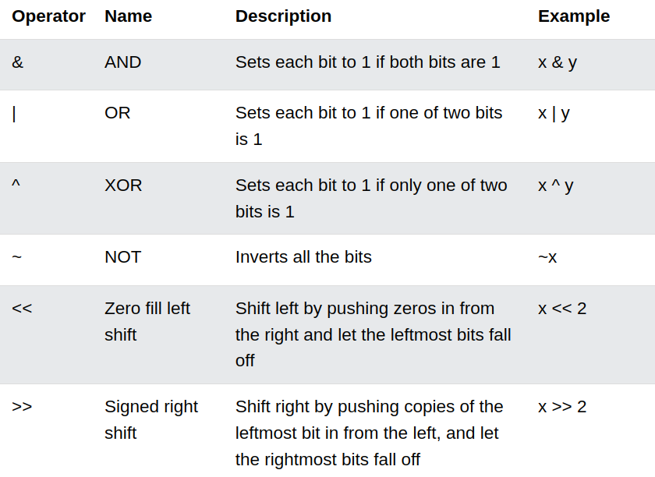
Bitwise Operators

Slide 47
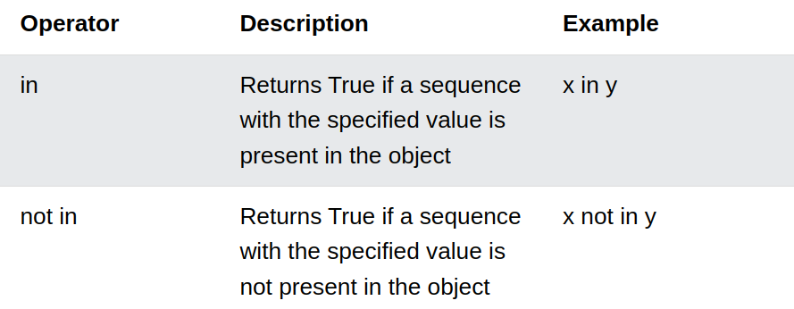
Membership Operators

Slide 48
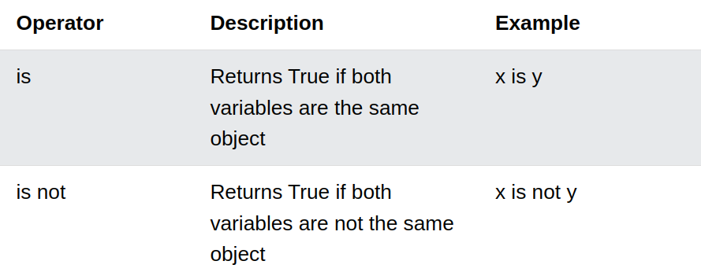
Identity Operators

Slide 49
Operators Precedence
Operator Description
() Parentheses
** Exponentiation
+x, -x, ~x Unary plus, unary minus, and bitwise NOT
*, /, //, % Multiplication, division, floor division, and modulus
+, - Addition and subtraction
<<, >>, &, ^, | Bitwise left and right shifts AND XOR OR
==, !=, >, >=, <, <= Comparison operators
is, is not Identity operators
in, not in Membership operators
not, and, or Logical operators

Slide 50
Statements in Python
A Python statement is an instruction that the Python interpreter can execute.
There are different types of statements in Python language as Assignment statements, Conditional statements, Looping statements, etc.
The token character NEWLINE is used to end a statement in Python. It signifies that each line of a Python script contains a statement. These all help the user to get the required output.
The different types of Python statements are listed below:
  Multi-Line Statements
  Conditional Statements
  Loop Statements

Slide 51
Multi-Line Statements
To extend the statement to one or more lines we can use braces {}, parentheses (), square [], semi-colon “;”, and continuation character slash “\”.
# Initialize the lines using continuation character
message = "Hello\
My\
Name is Baburam Shrestha"
print(message)
Line continuation are divided into two different ways:
  Explicit line continuation
  Implicit line continuation

Slide 52
Explicit Line Continuation (using ‘\’)
We will be using the line continuation character (\) to split a statement into multiple lines.
message = """ACME Engineering College,\
Affiliated to Purvanchal University,\
Provides Undergraduate and Graduate Degree Program\
like Computer Engineering,\
CIVIL Engineering,\
Architecture."""

Slide 53
Implicit Line Continuation using Parenthesis
It is used when you split a statement using either parenthesis ( ), brackets [ ], and braces { }.
# using parentheses "()"
message = (f"Hi,"
f"I am"
f"Baburam Shrestha")
print(message)

Slide 54
Implicit Line Continuation using Parenthesis
# using parentheses "{}"
my_list = {5,
4, 3, 2,
1
}
# using parentheses "[]"
numbers = [50,23
40 ,qw
52
print(numbers)

Slide 55
Implicit Line Continuation using triple quote
message = """
ACME Engineering College
Affiliated to Purvanchal University
Provides Undergraduate and Graduate Degree Program
like Computer Engineering
CIVIL Engineering
Architecture.
"""
print(message)

Slide 56
Control Statements
Types of Control Statements
  Conditional Statements:
    if Statement
    if-else Statement
    if-elif-else Statement
    match Statement
  Looping Statements:
    for Loop
    while Loop
  Control Flow Modifiers:
    break Statement
    continue Statement
    pass Statement

Slide 57
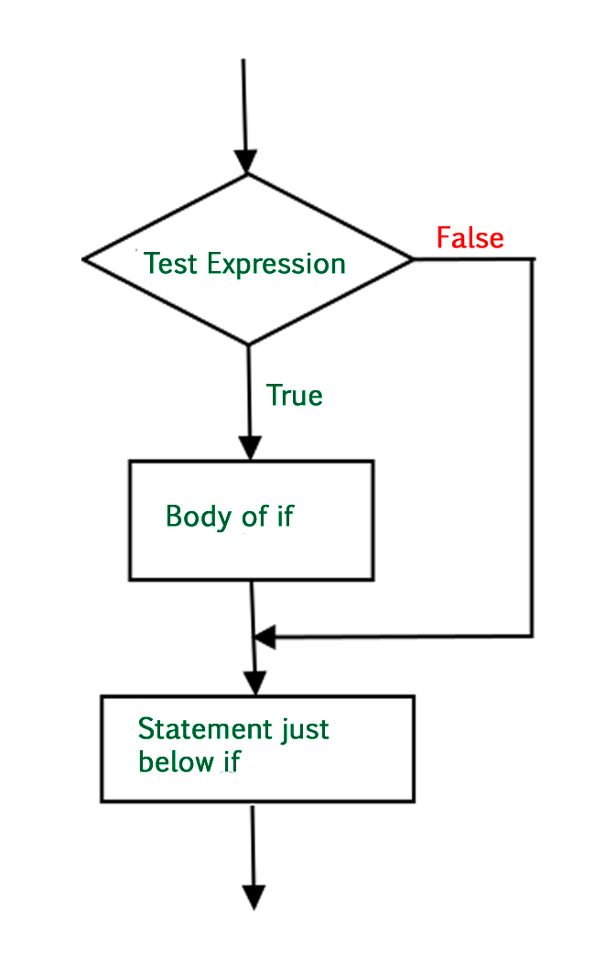
if Statements
The if statement is the most simple decision-making statement.
It is used to decide whether a certain statement or block of statements will be executed or not.
Syntax of if Statement in Python
if condition:
# Statements to execute if condition is true
Here, the condition after evaluation will be either true or false. if the statement accepts boolean values – if the value is true then it will execute the block of statements below it otherwise not.

Slide 58
if Statements Example
Example 1: Validation
age = 20
if age >0 :
print("Valid age")
Example 2: Eligibility
age = 10
if age < 18:
print("You cannot vote.")
Example 3: Checking different scenario
number = 20
if number % 2 == 0:
print("Even Number")

Slide 59
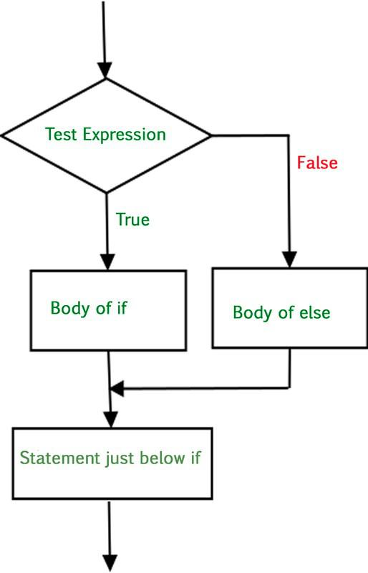
if-else Statements
The if statement alone tells us that if a condition is true it will execute a block of statements and if the condition is false it won’t. But if we want to do something else if the condition is false, we can use the else statement with the if statement Python to execute a block of code when the Python if condition is false.
Syntax of if-else Statement in Python
if condition:
# Statements to execute if condition is true
else:
# Statements to execute if condition is false

Slide 60
if-else Statements Example
Example 1:
age = 20
if age >= 18:
print("You can vote.")
else:
print("You cannot vote.")
Example 3:
number = 20
if number // 2 == 0:
print("Even Number")
else:
print("Odd Number")

Slide 61
Nested if-else Statements
A nested if is an if statement that is the target of another if statement. Nested if statements mean an if statement inside another if statement.
Yes, Python allows us to nest if statements within if statements. i.e., we can place an if statement inside another if statement.
Syntax of nested if-else Statement in Python
if condition1:
if condition2
# Statements to execute if condition2 is true
else:
# Statements to execute if condition2 is false
else:
# Statements to execute if condition1 is false

Slide 62
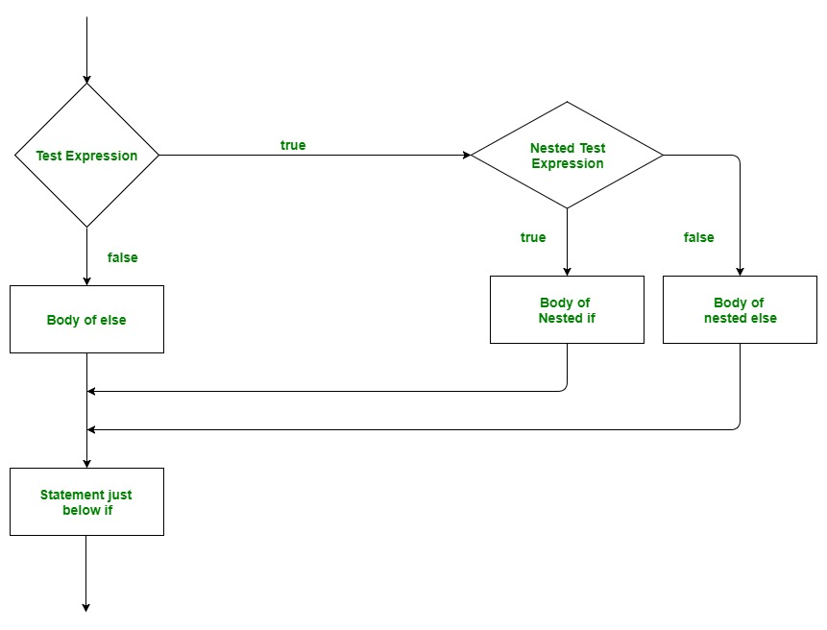
Nested if-else Statements

Slide 63
Nested If Statements Example
Example 1:
i = 10
# if statement
if (i == 10):
# First if statement
if (i < 15):
print("i is smaller than 15")
# Nested - if statement
# Will only be executed if statement above it is true
if (i < 12):
print("i is smaller than 12 too")
else:
print("i is greater than 15")

Slide 64
if-elif-else Ladder
User can decide among multiple options. The if statements are executed from the top down.
As soon as one of the conditions controlling the if is true, the statement associated with that if is executed, and the rest of the ladder is bypassed. If none of the conditions is true, then the final “else” statement will be executed.
Syntax for if-elif-else ladder:
if (condition1):
# statement
elif (condition2):
# statement
elif (condition3):
# statement
else:
# statement

Slide 65
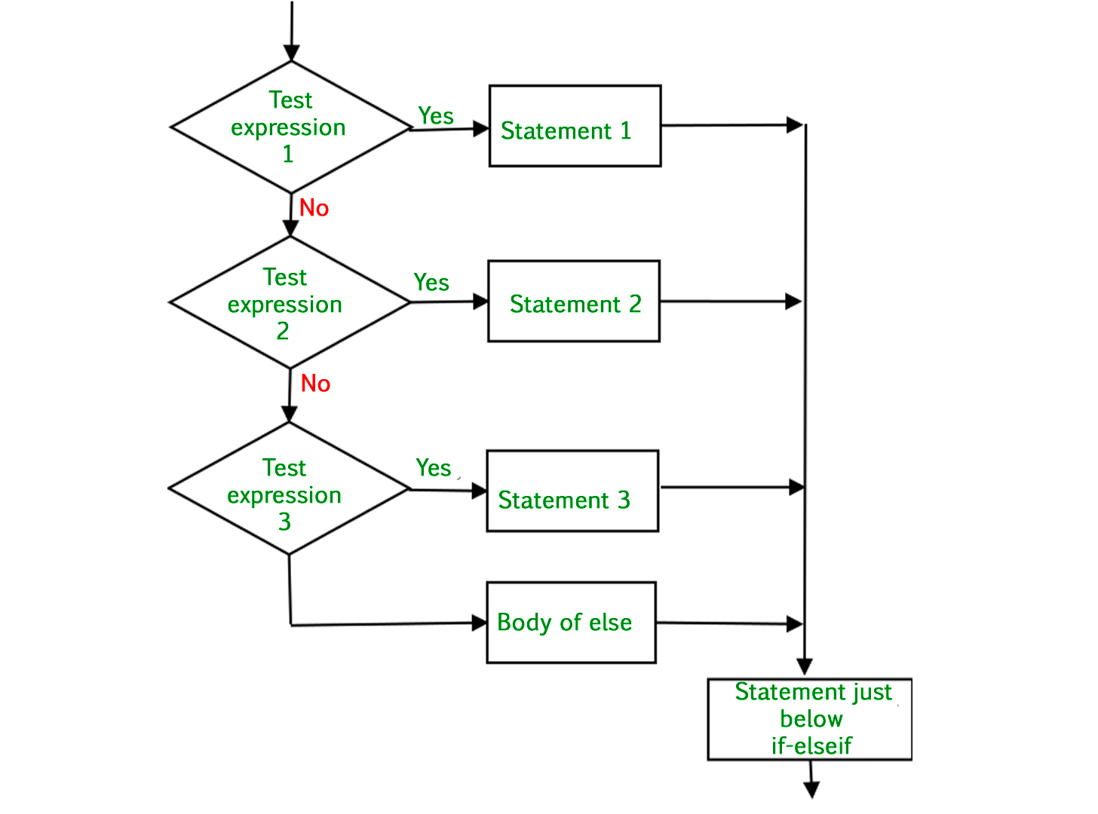
if-elif-else Ladder

Slide 66
if-elif-else Ladder Example
Example:
i = 25
if (i == 10):
print("i is 10")
elif (i == 15):
print("i is 15")
elif (i == 20):
print("i is 20")
else:
print("i is not present")

Slide 67
Multiple Conditions
To test multiple conditions in Python, you can use logical operators like and, or, and not. These operators allow you to combine or negate conditions within an if statement.
Using and
  The and operator allows you to check if multiple conditions are true at the same time. All conditions must be true for the block of code to execute.
age = 25
has_id = True
if age >= 18 and has_id:
print("You are allowed to enter.")
else:
print(“You cannot enter.")
In this example, both conditions (age >= 18 and has_id) must be true for the message "You are allowed to enter." to be printed.

Slide 68
Multiple Conditions
Using or
  The or operator allows you to check if at least one of multiple conditions is true. The block of code executes if at least one condition is true.
temperature = 15
raining = False
if temperature > 20 or not raining:
print("It's a good day for a walk.")
else:
print("Better stay indoors.")
Here, the message "It's a good day for a walk." is printed if either the temperature is greater than 20 or if it is not raining.

Slide 69
Multiple Conditions
Using not
  The not operator negates a condition, turning it true if it was false, and vice versa.
is_sunny = False
if not is_sunny:
print("It might rain today.")
else:
print("It's sunny today.")
In this case, the message "It might rain today." is printed if is_sunny is false.

Slide 70
Multiple Conditions
Combining Logical Operators
  You can combine multiple logical operators to test complex conditions.
age = 20
has_ticket = True
is_student = False
if age >= 18 and has_ticket and not is_student:
print("You can enter, but no discount is available.")
elif age >= 18 and has_ticket and is_student:
print("You can enter and get a student discount.")
else:
print("Entry not allowed.")

Slide 71
match Statement
Introduced in Python 3.10, it provides pattern matching capabilities similar to switch-case statements in other languages.
Pattern matching can make code more readable and concise, especially when dealing with multiple conditions or complex data structures.
It supports matching complex data structures, such as lists, tuples, and custom classes, allowing for more expressive and detailed conditional checks.
It provides a way to destructure and unpack data while matching, making it easier to handle and extract values from complex objects.
It can simplify code maintenance by centralizing condition handling in a single place, making it easier to understand and modify.

Slide 72
match Statement
def is_weekend(day):
return day in ["Saturday", "Sunday"]
def describe_day(day):
match day:
case "Monday":
return "Start of the work week."
case "Friday":
return "End of the work week."
case day if is_weekend(day):
return "Weekend!"
case _:
return "It's just another day."
print(describe_day("Monday"))
print(describe_day("Saturday"))
print(describe_day("Wednesday"))

Slide 73
Looping Statements
Looping Statements:
  for Loop
    Iterates over a sequence (like a list, tuple, dictionary, set, or string) or a range of numbers.
  while Loop
    Repeats a block of code as long as a specified condition is true.

Slide 74
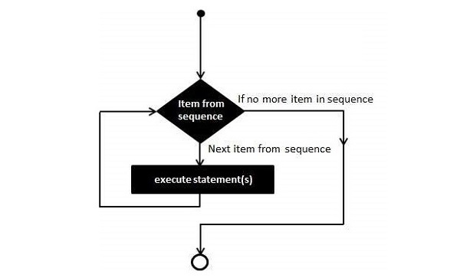
for Loop
Syntax of Python for Loop
for iterating_var in sequence:
# statement(s)

Slide 75
for Loop Example
Example 1:
numbers = [34,54,67,21,78,97,45,44,80,19]
total = 0
for num in numbers:
if num%2 == 0:
print (num)
Example 2:
numbers = (34,54,67,21,78,97,45,44,80,19)
total = 0
for num in numbers:
total += num
print ("Total =", total)
Example 3:
numbers = {10:"Ten", 20:"Twenty", 30:"Thirty",40:"Forty"}
for x in numbers:
print (x)

Slide 76
for Loop with Range Objects
Python's built-in range() function returns an iterator object that streams a sequence of numbers.
This object contains integers from start to stop, separated by step parameter. You can run a for loop with range as well.
The range() function has the following syntax −
range(start, stop, step)
Where,
Start − Starting value of the range. Optional. Default is 0
Stop − The range goes upto stop-1
Step − Integers in the range increment by the step value.
Option, default is 1.

Slide 77
for Loop with Range Objects Example
Example 1:
for num in range(5):
print (num, end=' ')
Example 2:
for num in range(10, 20):
print (num, end=' ')
Example 3:
for num in range(1, 10, 2):
print (num, end=' ')

Slide 78
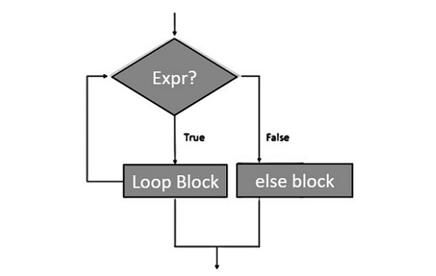
for-else Loop
Python supports an optional else block to be associated with a for loop. If a else block is used with a for loop, it is executed only when the for loop terminates normally.
The for loop terminates normally when it completes all its iterations without encountering a break statement, which allows us to exit the loop when a certain condition is met.
Example 1:
for count in range(6):
print ("Iteration no. {}".format(count))
else:
print ("for loop over. Now in else block")
print ("End of for loop")

Slide 79
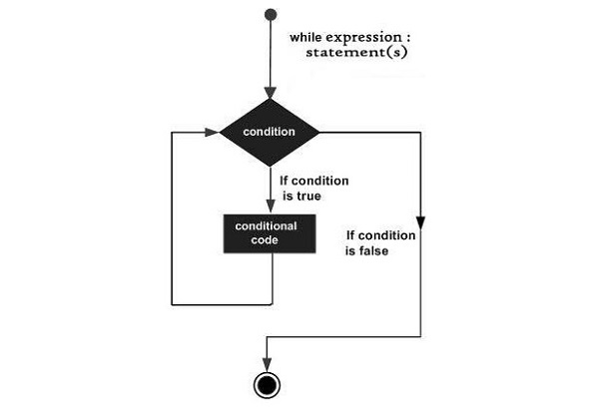
while Loop
Syntax of while Loop
The syntax of a while loop:
while expression:
#statement(s)
All the statements indented by the same number of character spaces after a programming construct are considered to be part of a single block of code.
Python uses indentation as its method of grouping statements.

Slide 80
while Loop Example
Example 1:
count=0
while count<5:
count+=1
print ("Iteration:{}".format(count))
print ("End of while loop")
Example 2:
var = '0'
while var.isnumeric() == True:
var = "test"
if var.isnumeric() == True:
print ("Your input", var)
print ("End of while loop")

Slide 81
while-else Loop
Python supports having an else statement associated with a while loop. If the else statement is used with a while loop, the else statement is executed when the condition becomes false before the control shifts to the main line of execution.
Example 1:
count=0
while count<5:
count+=1
print ("Iteration no. {}".format(count))
else:
print ("While loop over. Now in else block")
print ("End of while loop")

Slide 82
Control Flow Modifier
Control Flow Modifiers:
  break Statement
    Exits the nearest enclosing loop prematurely.
  continue Statement
    Skips the rest of the code inside the current iteration of a loop and proceeds to the next iteration.
  pass Statement
    A placeholder that does nothing and is used where code is syntactically required but not yet implemented.

Slide 83
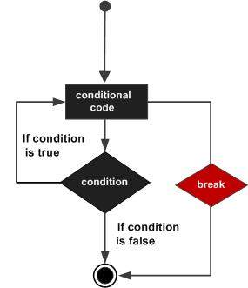
break Statement
The break statement in Python is used to terminate the execution of the current loop (either for or while) and resume execution at the next statement immediately after the end of that loop.
Using break:
  Inside a loop
  Multiple loops
  Function usage
  else clause

Slide 84
break Statement
Inside a loop
  If break is inside a nested loop, it will terminate the innermost loop.
Example:
letters = “Engineerings”
for letter in letters:
print(letter)
if letter == 'e' or letter == 's':
break
print("Out of for loop")
Multiple loops
  If break is inside a nested loop, it will terminate the innermost loop.
Example:
s = 'stringe'
i = 0
while i < len(s)-1:
while True:
print(s[i])
if s[i] == 'e':
break
i += 1
i += 1
print("Out of while loop")

Slide 85
break Statement
Function usage: A function can’t break on behalf of its caller. Instead, use return to exit the function and control flow will be passed back to the caller.
Example:
def stop_if_zero(a):
if int(a) == 0:
return True
else:
return False
while True:
value = input('Number: ')
if stop_if_zero(value):
break
else clause: If the loop is terminated by a break, the else clause will not be executed.
Example:
for i in range(5):
if i == 3:
break
print(i)
else:
print("Loop completed
normally")

Slide 86
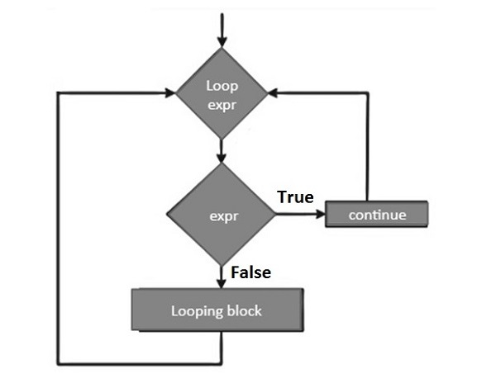
continue Statement
The continue statement in Python is used to skip the current iteration of a loop (either for or while) and immediately move to the next iteration of that loop.
Using continue:
  Inside a loop
  Multiple loops
  Function usage
  else clause

Slide 87
continue Statement
Inside a loop: continue must be syntactically inside the loop. When encountered, it skips the remaining code in the loop's body for the current iteration and proceeds to the next iteration.
Example:
for letter in "advanced":
if letter == 'a':
continue
print(letter)
print("Out of for loop")
Multiple loops: If continue is inside a nested loop, it will only skip the current iteration of the innermost loop where it is called.
Example:
for i in range(3):
for j in range(3):
if j == 1:
continue
print(f"i={i}, j={j}")

Slide 88
continue Statement
Function usage: continue can be used within a loop inside a function, but it cannot affect the outer calling context. You must use return if you want to exit the function instead.
Example:
def skip_if_zero(a):
if int(a) == 0:
return True
else:
return False
for i in range(5):
value = input('Number: ')
if skip_if_zero(value):
continue
print(f"Processing {value}")
else clause: The else clause after a loop executes only if the loop completes normally (i.e., it isn't terminated by a break statement). The continue statement does not prevent the else block from executing.
Example:
for i in range(5):
if i == 3:
continue
else:
print("Completed normally")

Slide 89
pass Statement
The pass statement in Python is a placeholder used when a statement is required syntactically but no code needs to be executed.
It is essentially a "do nothing" statement and can be useful when writing code that is yet to be implemented or as a placeholder in control structures.
Using pass:
  Inside a Loop or Conditional
  Function Usage
  Class Definition
  Exception Handling

Slide 90
pass Statement
Inside a Loop or Conditional: pass can be used inside loops or conditional statements when you don't want to perform any action but need to fulfill the syntactical requirement of having a statement.
Example 1:
for letter in 'abc':
pass
print("End of for loop")
Example 2:
x = 5
if x > 0:
pass
else:
print("x is not positive")
Function Usage: When defining a function that you haven't yet implemented, you can use pass to create the function without any code inside it.
Example:
def my_function():
pass
Using pass in this way allows the function to be defined without raising a syntax error.

Slide 91
pass Statement
Class Definition: pass can be used when you want to define a minimal class without methods or attributes.
Example:
class EmptyClass:
pass
Exception Handling: pass can also be used in try...except blocks where you don't want to take any action for a particular exception.
Example:
try:
1 / 0
except ZeroDivisionError:
pass
pass is a null operation - it does nothing when executed.
It is often used as a placeholder for code that will be written in the future.
Useful in loops, conditionals, function definitions, class definitions, and exception handling where no action is needed but a statement is required syntactically.

Slide 92
Functions in Python
Creating a Function in Python
  We can define a function in Python, using the def keyword. We can add any type of functionalities and properties to it as we require.
# A simple Python function
def fun():
print("Welcome to ME-Computer Class")
Calling a Function in Python
  After creating a function in Python we can call it by using the name of the functions Python followed by parenthesis containing parameters of that particular function.
# Driver code to call a function
fun()

Slide 93
Built In Functions in Python
Functions provide efficiency and structure to a programming language. Python has many useful built-in functions to make programming easier, faster, and more powerful.
The input() Function
  Programs usually require input that can come from different sources: keyboard, mouse clicks, database, another computer’s storage, or the internet.This function has an optional parameter called the prompt string.
The range() function
  Python has a more efficient way to handle a series of numbers and arithmetic progressions and this is by using one its built-in functions: range(). The range function is particularly useful in ‘for loops’.
  Example
list(range(5)) # [0, 1, 2, 3, 4]

Slide 94
Built In Functions in Python
abs()
  The abs() function returns the absolute value of a single number. It takes an integer or float number as argument and always returns a positive value.
abs(-10) # 10
max() / min()
  The max() / min() function takes two or more arguments and returns the largest/smallest one.
max(9, 12, 6, 15) # 15
min(23, -109, 5, 2) # -109
type()
  The type() function returns the data type of the given argument.
type(12) #<class 'int'>
type(12.5) #<class 'float'>
len()
  The len() function returns the length of an object or the number of items in a list given as argument.
len(“Cseworldonline”) #14

Slide 95
User Defined Functions in Python
Functions that we define ourselves to do certain specific task are referred as user-defined functions. The way in which we define and call functions in Python are already discussed.
If we use functions written by others in the form of library, it can be termed as library functions.
All the other functions that we write on our own fall under user-defined functions. So, our user-defined function could be a library function to someone else.

Slide 96
User Defined Functions in Python
# whether x is even or odd
def evenOdd(x):
if (x % 2 == 0):
print("even")
else:
print("odd")
# Driver code to call the function
evenOdd(2)
evenOdd(3)

Slide 97
User Defined Functions in Python
def is_prime(n):
if n in [2, 3]:
return True
if (n == 1) or (n % 2 == 0):
return False
r = 3
while r * r <= n:
if n % r == 0:
return False
r += 2
return True
print(is_prime(78), is_prime(79))

Slide 98
Arguments and Parameters in Functions
  Arguments and Parameters
    Arguments: Values provided when calling the function.
    Parameters: Variables in the function definition that hold argument values.
  Use Case: Dynamic data processing based on input.
  Features:
    Parameters are placeholders.
    Arguments are actual values passed.

Slide 99
Arguments and Parameters in Functions
Syntax:
def <funcion_name>(<parameter(s)> <data types>):
# Statements
<funcion_name>(<values(s)>) # function calling with arguments
Examples:
def multiply(x, y): # x and y are parameters
return x * y
multiply(5, 10) # 5 and 10 are arguments
def summation(a, b, c): # a, b, and c are parameters
return a+b+c
summation(50, 10, 500) # 50,10, and 500 are arguments

Slide 100
Python Functions Arguments
Types of Python Function Arguments
  Default argument
  Keyword arguments (named arguments)
  Positional arguments
  Arbitrary arguments (variable-length arguments *args and **kwargs)

Slide 101
Default Arguments
A default argument is a parameter that assumes a default value if a value is not provided in the function call for that argument.
def myFun(x, y=50):
print("x: ", x)
print("y: ", y)
# Driver code (We call myFun() with only argument)
myFun(10)
Like C++ default arguments, any number of arguments in a function can have a default value. But once we have a default argument, all the arguments to its right must also have default values.

Slide 102
Keyword Arguments
The idea is to allow the caller to specify the argument name with values so that the caller does not need to remember the order of parameters.
# Python program to demonstrate Keyword Arguments
def student(firstname, lastname):
print(firstname, lastname)
# Keyword arguments
student(firstname='Baburam', lastname='Shrestha')
student(lastname='Shyam', firstname='Gayak')

Slide 103
Positional Arguments
We used the Position argument during the function call so that the first argument (or value) is assigned to name and the second argument (or value) is assigned to age.
By changing the position, or if you forget the order of the positions, the values can be used in the wrong places.
def nameAge(name, age):
print("Hi, I am", name)
print("My age is ", age)
# You will get correct output because argument is given in order
nameAge(name="Suraj", age=27)
# You will get correct output because argument is not in order
nameAge(age=27, name="Suraj")

Slide 104
Arbitrary Arguments( *args, **kwargs)
In Python Arbitrary Keyword Arguments, *args, and **kwargs can pass a variable number of arguments to a function using special symbols.
There are two special symbols:
*args in Python (Non-Keyword Arguments)
**kwargs in Python (Keyword Arguments)

Slide 105
Arbitrary Arguments( *args, **kwargs)
Example 1: Variable length non-keywords argument
# *args for variable number of arguments
def myFun(*argv):
for arg in argv:
print(arg)
# Driver code
myFun('Hello', 'I', 'am', 'Baburam', 'Shrestha')
Output:
Hello
I
am
Baburam
Shrestha

Slide 106
Arbitrary Arguments( *args, **kwargs)
Example 2: Variable length keyword arguments
# *kwargs for variable number of keyword arguments
def myFun(**kwargs):
for key, value in kwargs.items():
print("%s == %s" % (key, value))
# Driver code
myFun(first='Babu', mid='Ram', last='Shrestha')
Output:
first==Babu
mid==Ram
last==Shrestha

Slide 107
Docstring in Python
The first string after the function is called the Document string or Docstring in short. This is used to describe the functionality of the function. The use of docstring in functions is optional but it is considered a good practice.
Syntax:
print(function_name.__doc__)
Example:
Adding Docstring to the function
def even(x):
"""Function to check if the number is even or odd"""
if (x % 2 == 0):
print("even")
# Driver code to call the function
print(even.__doc__)
Output:
Function to check if the number is even or odd

Slide 108
Docstring in Python
def add_numbers(a: int, b: int) -> int:
"""
Adds two numbers and returns the result.
Parameters:
a (int): The first number.
b (int): The second number.
Returns:
int: The sum of a and b.
"""
return a + b

Slide 109
Functions within Function
A function that is defined inside another function is known as the inner function or nested function. Nested functions can access variables of the enclosing scope. Inner functions are used so that they can be protected from everything happening outside the function.
# Python program to demonstrate accessing of variables of nested functions
def f1():
s = 'Hi, My Name is Baburam Shrestha'
def f2():
print(s)
f2()
# Driver's code
f1()

Slide 110
Recursive Functions in Python
Recursion in Python refers to when a function calls itself. There are many instances when you have to build a recursive function to solve Mathematical and Recursive Problems.
Using a recursive function should be done with caution, as a recursive function can become like a non-terminating loop. It is better to check your exit statement while creating a recursive function.
Example 1:
def factorial(n):
if n == 0:
return 1
else:
return n * factorial(n - 1)
print(factorial(4))

Slide 111
Lambda Functions in Python
Anonymous Function: A lambda function is a small, unnamed (anonymous) function that is defined using the lambda keyword.
Single Expression: It can have any number of arguments but only one expression, which is evaluated and returned.
Compact & Readable: Lambda functions are often used for short, simple operations where defining a full function is unnecessary.
Used in Higher-Order Functions: They are commonly used with functions like map(), filter(), and reduce().
No Return Keyword: The result of the expression is implicitly returned, meaning there's no need for an explicit return statement.
Syntax:
variable_to_hold_value = lambda parameter(s) : operations on parameter(s)

Slide 112
Anonymous Functions in Python
Example 1:
def cube(x):
return x*x*x
print(cube(7))
cube_v2 = lambda x : x*x*x
print(cube_v2(7))
Example 2:
add = lambda a, b: a + b
print(add(3, 7))
Example 3:
numbers = [1, 2, 3, 4, 5, 6]
even_numbers = list(filter(lambda x: x % 2 == 0, numbers))
print(even_numbers)

Slide 113
List in Functions
We can define a function that accepts a list as an argument and returns a new list based on the input.
  Accepting a List as an Argument
    The function that takes a list as a parameter. Within the function, you can perform various operations on the list.
  Returning a List
    The function can return a new list, which can be a modified version of the input list or a completely new list created from it.

Slide 114
List in Functions
Example 1: Sum of Elements of a List
Let's create a function that accepts a list of numbers and returns a sum of elements of list.
def sum_elements(input_list):
sum = 0
for x in input_list:
sum += x
return sum
# Example usage:
original_list = [1, 2, 3, 4, 5]
result = sum_elements(original_list)
print("Original List:", original_list)
print("Sum of Elements in List:", result)

Slide 115
Tuple in Functions
A tuple is an immutable sequence type that can store a collection of items. Tuples can be used as function arguments, allowing you to pass multiple values to a function and also to return multiple values from a function.
  Function that Accepts a Tuple and Returns single value
    A function that accepts a tuple as an argument, processes it, and returns a single value:
  Function that Accepts and Returns a Tuple
    A function that accepts a tuple as an argument, processes it, and returns a new tuple

Slide 116
Tuple in Functions
Example 1: Finding the multiplication of elements in Tuple
Let's create a function that accepts a tuple of numbers and returns a single value.
def find_multiply(input_tuple):
mul = 1
for elem in input_tuple:
mul *= elem
return mul
# Example usage
data = (1, 2, 3, 4, 5)
result = find_multiply(data)
print("Input Tuple:", data)
print("Multiply of elements in Tuple:", result)

Slide 117
Dictionary in Functions
A dictionary is a built-in data type that stores data in key-value pairs. When you create a function that accepts a dictionary as an argument and returns a dictionary, you can manipulate or process the data within that dictionary as needed.
Explanation of Dictionary in Functions
  Defining a Function: You can define a function that takes a dictionary as an argument.
  Accessing Dictionary Items: Inside the function, you can access the values associated with specific keys in the dictionary.
  Returning a Dictionary: You can create a new dictionary, modify the original one, or simply return a copy of it.

Slide 118
Dictionary in Functions
Let’s create a function that accepts a dictionary of student names and their grades, and returns a new dictionary containing only those students who have passed (assuming a passing grade is 50).
def filter_passed_students(grades_dict):
passed_students = {}
for student, grade in grades_dict.items():
if grade >= 50:
passed_students[student] = grade
return passed_students
passed_students= filter_passed_students(student_grades)
print(passed_students)
# Example usage:
student_grades = {
'Alice': 85,
'Bob': 45,
'Charlie': 70,
'David': 30,
'Eva': 90
}

Slide 119
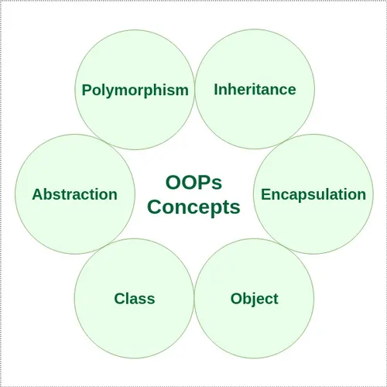
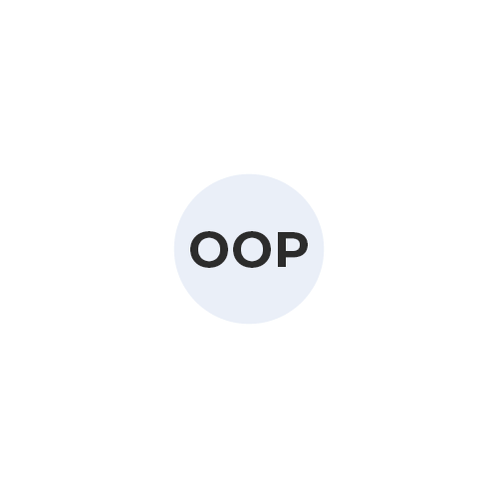
Object Oriented Programming (OOP)
OOP is a programming paradigm that uses objects and classes in programming. It aims to implement real-world entities like inheritance, polymorphisms, encapsulation, etc. in the programming. The main concept of oop in Python is to bind the data and the functions that work together as a single unit so that no other part of the code can access this data.

Slide 120
Object Oriented Programming (OOP)
The 4 pillars of object-oriented programming (OOP) in Python (and generally in programming) are:
Encapsulation: Bundling data (attributes) and methods (functions) that operate on the data into a single unit (class).
Abstraction: Hiding complex implementation details and providing a simplified interface.
Inheritance: Allowing a class to inherit attributes and methods from another class, promoting code reuse.
Polymorphism: Using a single interface to represent different data types or objects.

Slide 121
Class in Python
Some points on Python class:
Classes are created by keyword class.
Attributes are the variables that belong to a class.
Attributes are always public and can be accessed using the dot (.) operator. Eg.: Myclass.Myattribute
Created a class named Dog using the class keyword.
class Dog:
pass

Slide 122
Object in Python
The object is an entity that has a state and behavior associated with it. It may be any real-world object like a mouse, keyboard, chair, table, pen, etc. Integers, strings, floating-point numbers, even arrays, and dictionaries, are all objects.
An object consists of:
  State: It is represented by the attributes of an object. It also reflects the properties of an object.
  Behavior: It is represented by the methods of an object. It also reflects the response of an object to other objects.
  Identity: It gives a unique name to an object and enables one object to interact with other objects.

Slide 123
Class and Object in Python
class Dog:
attr1 = "mammal" # Class attribute
# Driver code
rodger = Dog() # Object instantiation
rodger.name = "Rodger"
tommy = Dog()
tommy.name = "Tommy"
# Accessing class attributes
print("Rodger is a {}".format(rodger.__class__.attr1))
print("Tommy is also a {}".format(tommy.__class__.attr1))
# Accessing instance attributes
print("My name is {}".format(rodger.name))
print("My name is {}".format(tommy.name))
Output:
Rodger is a mammal
Tommy is also a mammal
My name is Rodger
My name is Tommy

Slide 124
Class and Object in Python
class Dog:
attr1 = "mammal" # Class attribute
def __init__(self, name):
self.name=name # class instance attributes
def speak(self):
print(‘f Dog name: {self.name}’)
# Driver code
rodger = Dog("Rodger" ) # Object instantiation
tommy = Dog("Tommy")
# Accessing class methods
rodger.speak()
tommy.speak()
# Accessing instance attributes
print("My name is {}".format(rodger.name))
print("My name is {}".format(tommy.name))
Output:
My name is Rodger
My name is Tommy

Slide 125
Class Constructor in Python
__init__() is a special method (constructor) in Python classes. It’s automatically called when a new instance (object) of the class is created. Its primary purpose is to initialize the object’s attributes or perform any setup required for the object.
class Dog:
attr1 = "mammal" # Class attribute
def __init__(self, name):
self.name=name # class instance attributes
def speak(self):
print(‘f Dog name: {self.name}’)

Slide 126
self in Class Constructor in Python
The __init__ method is similar to constructors in C++ and Java. It is run as soon as an object of a class is instantiated. The method is useful to do any initialization you want to do with your object.
'self' is a convention in Python used to refer to the instance of a class (object) itself. It’s the first parameter of instance methods and refers to the object calling the method.
It allows methods to access and manipulate attributes (variables) that belong to the instance.

Slide 127
Making an Instance from a Class
class Employee:
def __init__(self, name, salary):
self.name = name
self.salary = salary
emp1 = Employee("John Doe", 5000)
emp2 = Employee("Jane Smith", 6000)
Employee is a class with a constructor method __init__ that takes two arguments name and salary. Two instances, emp1 and emp2, are created by calling the constructor method with different arguments.

Slide 128
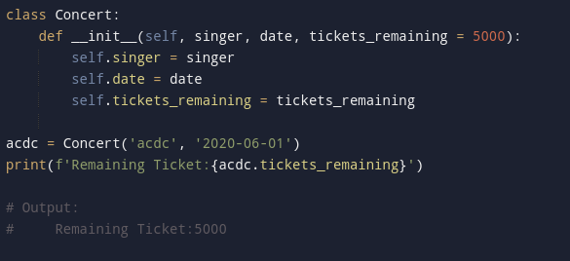
Setting a Default Attributes Values
It is possible to set a default value for an attribute when defining a class.
Below we have a class Concert, where the attribute tickets_remaining of each instance always starts at 5000 when the particular concert is announced.
To define the class Concert with default value of attribute tickets_remaining of 5000.
we do not have to provide a value for tickets_remaining when instantiating the object.

Slide 129
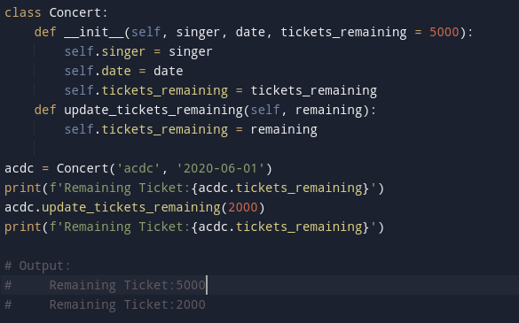
Changing a Default Attributes Values
It is possible to change default value for an attribute.
Changing the default value of attribute tickets_remaining of 5000, and change the value to 2000.

Slide 130
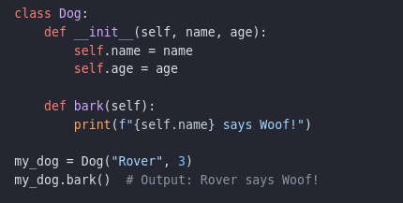
Class and object in Python
__init__ method: Initializes objects when created, setting attributes.
self parameter: References the current object instance in methods.
Attributes: Data stored within an object, accessed using dot notation (e.g., obj.attribute).
Methods: Functions defined within a class, operating on object attributes.

Slide 131
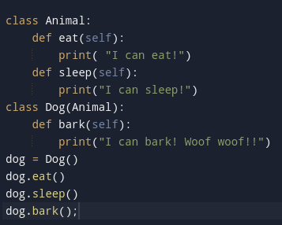

Inheritance in Python
Inheritance is a way of creating a new class for using details of an existing class without modifying it.
The newly formed class is a derived class (or child class). Similarly, the existing class is a base class (or parent class).

Slide 132
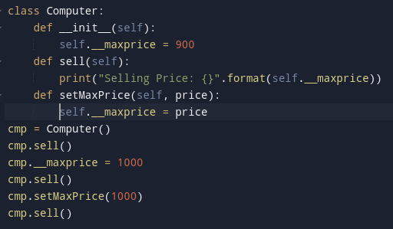

Encapsulation in Python
Encapsulation is one of the key features of object-oriented programming. Encapsulation refers to the bundling of attributes and methods inside a single class.
It prevents outer classes from accessing and changing attributes and methods of a class. This also helps to achieve data hiding.
We denote private attributes using underscore as the prefix i.e single _ or double __.

Slide 133
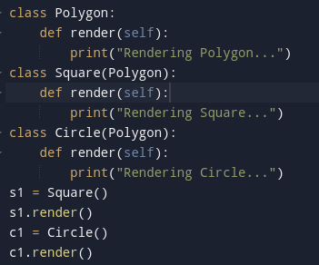

Polymorphism in Python
Polymorphism is another important concept of object-oriented programming. It simply means more than one form.
That is, the same entity (method or operator or object) can perform different operations in different scenarios.

Slide 134
OOP in Python
Object-Oriented Programming makes the program easy to understand as well as efficient.
Since the class is sharable, the code can be reused.
Data is safe and secure with data abstraction.
Polymorphism allows the same interface for different objects, so programmers can write efficient code.

Slide 135
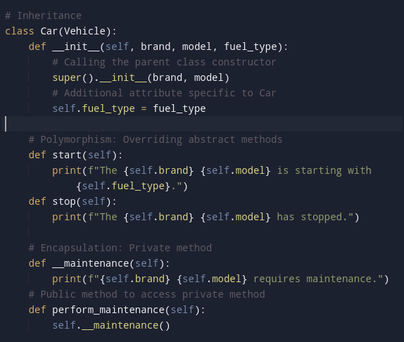
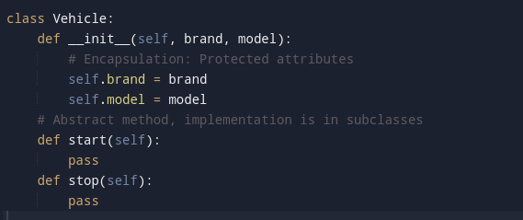
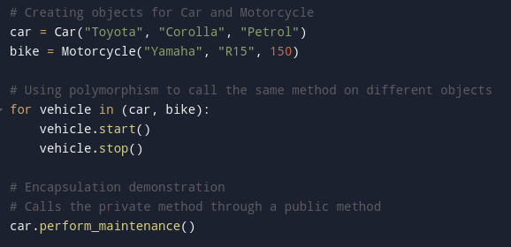
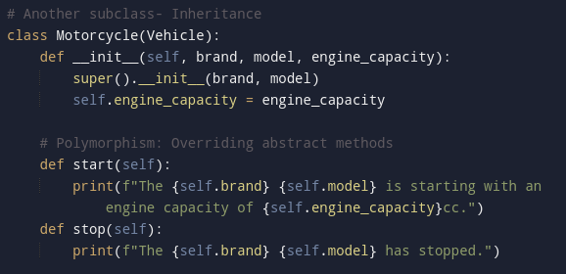
Vehicle Example

Slide 136
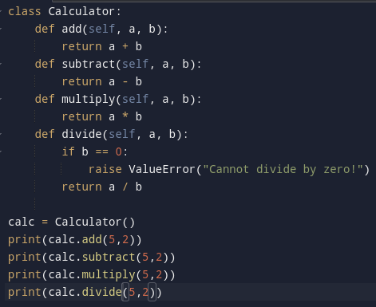
Write a Python program to create a Calculator class with basic arithmetic operations (addition, subtraction, multiplication, division)

Slide 137
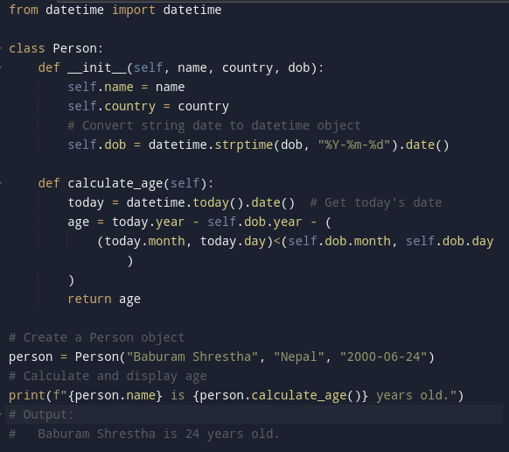
Write a Python program to create a person class. Include attributes like name, country, and date of birth. Implement a method to determine the person’s age.

Slide 138
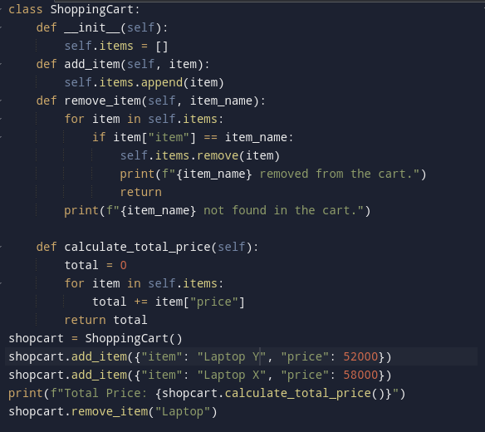
Write a Python program to create a class representing a shopping cart. Include methods for adding and removing items, and calculating the total price.

Slide 139
Directories / Folders using Python
In Python, you can work with directories using the built-in os and pathlib modules.
These modules provide functionalities for creating, deleting, and navigating directories, as well as retrieving information about them.
  Using the os Module
    The os module provides a normal approach to working with directories.
  Using the pathlib Module
    The pathlib module provides a more object-oriented approach to working with directories.

Slide 140
Directories using Python
Using the os Module
Importing the os Module
  Before you start working with directories, you need to import the os module:
import os
Creating a Directory
  You can create a new directory using os.mkdir() or os.makedirs().
  The os.makedirs() function can create intermediate directories as well.
# Create a single directory
os.mkdir('my_directory')
# Create nested directories
os.makedirs('parent_directory/child_directory')

Slide 141
Directories using Python
Using the os Module
Listing Files in a Directory
  To list files and subdirectories in a directory, you can use os.listdir().
files = os.listdir('my_directory')
print(files)
Changing the Current Working Directory
  You can change the current working directory using os.chdir().
os.chdir('my_directory')
print("Current Working Directory:", os.getcwd())
Deleting a Directory
  You can remove a directory using os.rmdir() (for empty directories) or os.removedirs() (for nested directories).
os.rmdir('my_directory') # Remove an empty directory
os.removedirs('parent_directory/child_directory') # Remove nested directories

Slide 142
Directories using Python
Using the pathlib Module
Importing the pathlib Module
from pathlib import Path
Creating a Directory
  You can create a directory using the mkdir() method.
# Create a single directory
Path('my_directory').mkdir(exist_ok=True)
# Create nested directories
Path('parent_directory/child_directory').mkdir(parents=True, exist_ok=True)
Listing Files in a Directory
  You can list all files in a directory using the iterdir() method.
for file in Path('my_directory').iterdir():
print(file)

Slide 143
Directories using Python
Using the pathlib Module
Changing the Current Working Directory
  Unlike os, pathlib doesn’t provide a direct method to change the working directory, but you can get the current path easily:
current_path = Path.cwd()
print("Current Working Directory:", current_path)
Deleting a Directory
  You can remove directories using the rmdir() method (for empty directories) or the shutil module for non-empty directories.
import shutil
# Remove an empty directory
Path('my_directory').rmdir()
# Remove a non-empty directory
shutil.rmtree('parent_directory')

Slide 144
Files using Python
Files are used to store data persistently, allowing you to read from and write to files on your system.
The built-in open() function, along with methods provided by file objects, facilitates file operations.
Types of Files
  Text Files:
    These files store data in a readable format (e.g., .txt, .csv, .json). Each line of the file is treated as a string.
  Binary Files:
    These files contain data in binary format (e.g., .bin, images, audio files). Data is not directly human-readable.

Slide 145
Files in Python
In Python, you can perform various operations on files, such as renaming, moving, copying, and removing them using the built-in os and shutil modules.
Importing the Required Modules
  Before you can perform file operations, you need to import the necessary modules:
import os
import shutil
Renaming a File
  To rename a file, you can use the os.rename() function.
# Renaming a file
os.rename('old_filename.txt', 'new_filename.txt')

Slide 146
Files in Python
Moving a File
  To move a file from one location to another, you can also use the shutil.move() function.
# Moving a file
shutil.move('source_directory/filename.txt', 'destination_directory/filename.txt')
Copying a File
  You can copy a file using the shutil.copy() or shutil.copy2() functions. The shutil.copy2() also copies the file’s metadata.
shutil.copy('source_directory/filename.txt', 'destination_directory/filename_copy.txt')
# Using copy2 for metadata
shutil.copy2('source_directory/filename.txt', 'destination_directory/filename_copy2.txt')

Slide 147
Files in Python
Removing a File
  To remove a file, use the os.remove() function. This function can only remove files, not directories.
# Removing a file
os.remove('filename.txt')
  If you need to remove a directory, you can use os.rmdir() for empty directories or shutil.rmtree() for directories that contain files.
# Removing an empty directory
os.rmdir('empty_directory')
# Removing a directory and its contents
shutil.rmtree('non_empty_directory')

Slide 148
Files Operations in Python
File Operations:
1. Opening a File
2. Reading from a File
3. Writing to a File
4. Appending to a File
5. Closing a File

Slide 149
Files using Python
Opening a File
You can open a file using the open() function. The basic syntax is:
file_object = open('filename', 'mode')
filename: The name of the file to be opened.
mode: The mode in which the file should be opened (read, write, append, etc.).
Mode | Description
r | Read (default mode). Opens the file for reading.
w | Write. Opens the file for writing (overwrites existing content).
a | Append. Opens the file for writing at the end of the file.
b | Binary mode. Opens the file in binary format.
t | Text mode (default). Opens the file in text format.
x | Exclusive creation. Fails if the file already exists.

Slide 150
Files using Python
Reading from a File
You can read from a file using several methods:
read(size): Reads the specified number of bytes. If no size is specified, it reads until EOF.
with open('file.txt', 'r') as f:
content = f.read()
readline(): Reads a single line from the file.
with open('file.txt', 'r') as f:
line = f.readline()
readlines(): Reads all lines in a file and returns a list of lines.
with open('file.txt', 'r') as f:
lines = f.readlines()

Slide 151
Files using Python
Writing to a File
You can write to a file using the following methods:
write(string): Writes a string to the file.
with open('file.txt', 'w') as f:
f.write("Hello, World!")
writelines(lines): Writes a list of strings to the file.
with open('file.txt', 'w') as f:
f.writelines(["Line 1\n", "Line 2\n", "Line 3\n"])

Slide 152
Files using Python
Appending to a File
To append data to an existing file, use the a mode:
with open('file.txt', 'a') as f:
f.write("This line is appended.\n")
Closing a File
If you do not use a context manager, make sure to close the file using file_object.close() to free up resources.
with open('file.txt', 'a') as f:
# file operations
f.close()

Slide 153
Files using Python
Appending to a File
To append data to an existing file, use the a mode:
with open('file.txt', 'a') as f:
f.write("This line is appended.\n")
Closing a File
If you do not use a context manager, make sure to close the file using file_object.close() to free up resources.
with open('file.txt', 'a') as f:
# file operations
f.close()

Slide 154
Error / Exception in Python
Errors are problems in a program that causes the program to stop its execution.
When an exception occurs, Python stops executing the program and throws an error message unless the exception is handled.
Exceptions are raised when some internal events change the program’s normal flow.
Exceptions are different from syntax errors, as they occur during program execution (runtime).
There are multiple types of Error in python, Some are:
  Syntax Errors: Errors due to incorrect or invalid syntax in the code, preventing the compiler or interpreter from correctly interpreting or executing the code.
  Logical Errors: Errors resulting from flawed logic in conditional statements, loops, or algorithms, leading to incorrect control flow or results.

Slide 155
Error / Exception in Python
There are multiple types of Error in python, Some are:
  Compile-Time Errors: Errors detected by the compiler during the compilation process, including syntax errors and static semantic errors.
  Run-Time Errors: Errors detected during the execution of the program, including:
    Arithmetic Errors: Mistakes in mathematical calculations or operations, resulting in incorrect results or program crashes.
    Resource Errors: Issues related to the allocation, utilization, or availability of system resources such as memory, file handles, network connections, or CPU cycles.

Slide 156
Compile-time / Syntax Error in Python
When the proper syntax of the language is not followed then a syntax error is thrown.
Example 1 : It returns a syntax error message because after the if statement a colon: is missing. We can fix this by writing the correct syntax.
age= 19
if(age>18) # cause syntax error
print("You are eligible to vote.”)
# Solution:
age= 19
if(age>18):
print("You are eligible to vote.”)

Slide 157
Compile-time / Syntax Error in Python
Example 2: When indentation is not correct.
age=20
if(age>18):
print("You are eligible to vote.”)
Example 3: When indentation is not correct in looping.
ages =[58,88,48,65]
for age in ages:
if age>18:
print(f"Man/Woman with {age} can vote.”)

Slide 158
Run-time / Logical Error in Python
A logical error in Python, is a type of bug that occurs when a program runs without crashing but produces incorrect or unintended results.
Logical errors are mistakes in the program’s logic that lead to incorrect behavior or output, despite the syntax being correct.
Characteristics of Logical Errors
  No Syntax Error: The code runs successfully without any syntax errors.
  Unexpected Output: The program produces output that is different from what is expected.
  Difficult to Detect: Logical errors can be subtle and are often harder to identify and fix compared to syntax errors because the program appears to run correctly.
  Varied Causes: They can arise from incorrect assumptions, faulty logic, improper use of operators, or incorrect sequence of instructions.

Slide 159
Run-time / Logical Error in Python
Example 1: To compute the average of a list of numbers:
numbers = [10, 20, 30, 40, 50]
total = 0
for number in numbers:
total += number
# Calculate the average (this has a logical error)
average = total / len(numbers) - 1​
print("The average is:", average)
Analysis
  Expected Output: The average of the numbers [10, 20, 30, 40, 50] should be 30
  Actual Output: The program will output The average is: 29.0

Slide 160
Run-time / Logical Error in Python
Example 1: To compute the average of a list of numbers:
numbers = [10, 20, 30, 40, 50]
total = 0
for number in numbers:
total += number
# Calculate the average (this has a logical error)
average = total / len(numbers)
print("The average is:", average)
Analysis
  Expected Output: The average of the numbers [10, 20, 30, 40, 50] should be 30
  Actual Output: The program will output The average is: 30

Slide 161
Built In Error in Python
IndexError: Raised when attempting to access a list or tuple with an invalid index.
AssertionError: Occurs when an assert statement fails.
AttributeError: Raised when an invalid attribute reference or assignment is made.
ImportError: Raised when a module or its attributes cannot be imported.
KeyError: Raised when attempting to access a dictionary with a key that does not exist.
NameError: Raised when trying to use a variable that has not been defined.
MemoryError: Occurs when a program runs out of memory.
TypeError: Raised when an operation or function is applied to an object of an inappropriate type.

Slide 162
Error in Python
Aspect Compile-time Error Run-time Error
Detection Time Before the program runs While the program is running
Error Type Syntax-related issues Logic or operational issues
Examples SyntaxError, IndentationError ZeroDivisionError, IndexError

Slide 163
Handling Exception in Python
1. Unhandled Exception
x = 10
y = 0
print(x / y)
Output: ZeroDivisionError: division by zero
Explanation: Dividing a number by zero is not allowed in mathematics. Python raises a ZeroDivisionError exception in this case.

Slide 164
Handling Exception in Python
2. Handling Exceptions Using try and except
You can handle exceptions to prevent the program from crashing.
try:
x = 10
y = 0
print(x / y)
except ZeroDivisionError:
print("Error: Cannot divide by zero.")
Output: Error: Cannot divide by zero.
Explanation: The try block contains code that might raise an exception. The except block catches and handles the exception if it occurs.

Slide 165
Handling Exception in Python
3. Handling Multiple Exceptions
You can handle different exceptions using multiple except blocks.
try:
lst = [1, 2, 3]
print(lst[5]) # This will cause an IndexError
except IndexError:
print("Error: Index out of range.")
except ZeroDivisionError:
print("Error: Cannot divide by zero.")
Output: Error: Index out of range.
Explanation: Since an IndexError occurs, the corresponding except block executes.

Slide 166
Handling Exception in Python
4. Using finally: The finally block executes code no matter what happens in the try block.
try:
x = 10
y = 2
print(x / y)
except ZeroDivisionError:
print("Error: Cannot divide by zero.")
finally:
print("Execution completed.")
Output: 5.0 \n Execution completed.
Explanation: The finally block executes regardless of whether an exception occurred.

Slide 167
Handling Exception in Python
5. Standard/Generalized Exceptions
You can define Generalized exceptions.
try:
pass
#python statements
except Exception as e:
raise Exception(f"This is a custom exception. Error: {e}")
Output: his is a custom exception. Error: …………

Slide 168
Exception in Python
File Not Found: When trying to open a file that does not exist, a FileNotFoundError occurs.
try:
with open("data.txt", "r") as file:
content = file.read()
print(content)
except FileNotFoundError:
print("Error: The file was not found. Please check the file path.")
Output: Error: The file was not found. Please check the file path.

Slide 169
Modules in Python
A module in Python is a file containing Python definitions and statements. The file name is the module name with the suffix .py appended. Within a module, the module’s name (as a string) is available as the value of the global variable __name__.
Importing Modules
Import by the module name:
import math
print("Square root of 100:", math.sqrt(100))
Import specific functions or variables from a module using the from keyword:
from math import sqrt
print("Square root of 100:", sqrt(100))

Slide 170
Built-in Modules in Python
Python’s standard library comes bundled with a large number of modules, known as built-in modules. These modules are written in C and pre-compiled into the library.
Some examples of built-in modules include:
  math: provides mathematical functions, import math
  string: provides string processing functions, import string
  re: provides regular expression facilities, import re
  os: provides operating system functions, import os
  sys: provides system-specific functions, import sys

Slide 171
Modules in Python
A Python module is a file containing Python definitions and statements. A module can define functions, classes, and variables.
A module can also include runnable code.
Grouping related code into a module makes the code easier to understand and use. It also makes the code logically organized.
Create a Python Module
  To create a Python module, write the desired code and save that in a file with .py extension.
Import module in Python
  We can import the functions, and classes defined in a module to another module using the import statement in some other Python source file.
  When the interpreter encounters an import statement, it imports the module if the module is present in the search path.

Slide 172
Modules in Python
Let’s create a simple calculator.py in which we define two functions.
# A simple module, calculator.py
def add(x, y):
return (x+y)
def subtract(x, y):
return (x-y)
Let’s import the function from calculator.py file
# calc.py, importing module calculator.py
import calculator
print(calculator.add(10, 2))
print(calculator.calculator(10, 2))
Output: 12
8

Slide 173
Import From Modules
Python’s from statement lets you import specific attributes from a module without importing the module as a whole.
Import Specific Attributes from a Python module: Here, we are importing specific sqrt and factorial attributes from the math module.
# importing sqrt() and factorial from the module math
from math import sqrt, factorial
# if we simply do "import math", then
# math.sqrt(16) and math.factorial() # are required.
print(sqrt(16))
print(factorial(6))
Output:
4.0
720

Slide 174
Import All From Modules
The * symbol used with the import statement is used to import all the names from a module to a current namespace.
Syntax:
  from module_name import *
What does import * do in Python?
The use of * has its advantages and disadvantages. If you know exactly what you will be needing from the module, it is not recommended to use *, else do so.
from math import *
print(sqrt(16))
print(factorial(6))
Output
4.0
720

Slide 175
Renaming the Module
We can rename the module while importing it using the keyword.
Syntax: Import Module_name as Alias_name
# importing sqrt() and factorial from the module math
import math as mt
# if we simply do "import math", then
# math.sqrt(16) and math.factorial() are required.
print(mt.sqrt(16))
print(mt.factorial(6))
Output:
4.0
720

Slide 176
Packages in Python
Python Packages are a way to organize and structure your Python code into reusable components.
Think of it like a folder that contains related Python files (modules) that work together to provide certain functionality.
Packages help keep your code organized, make it easier to manage and maintain, and allow you to share your code with others.
They’re like a toolbox where you can store and organize your tools (functions and classes) for easy access and reuse in different projects.

Slide 177
Packages in Python
Here’s a sample demonstrating how to create a simple Python package:
Create a directory named mypackage.
Inside mypackage, create two Python files: module1.py and module2.py.
Create an __init__.py file inside mypackage (it can be empty).
Add some code to the modules.
Finally, demonstrate how to import and use the modules from the package.
mypackage/
│
├── __init__.py
├── module1.py
└── module2.py

Slide 178
Packages in Python
# module1.py
def greet(name):
print(f"Hello, {name}!")
from mypackage import module1, module2
# Using functions from module1
module1.greet("Alice")
# Using functions from module2
result = module2.add(3, 5)
print("The result if addition is : {result}”)
# module2.py
def add(a, b):
return a + b

Slide 179
Packages in Python
Python packages tailored for AI and machine learning applications. From performing statistical analysis and visualizing data to delving into advanced topics like deep learning, natural language processing (NLP), generative AI, and computer vision, these packages offer a comprehensive toolkit for tackling diverse challenges in the field.
Statistical analysis (NumPy, SciPy, Pandas)
Data Visualization ( Matplotlib, Seaborn, Plotly)
Deep Learning( Scikit-learn, Tensorflow, torch)
Natural Language Processing( NLTK, spaCy, Transformers)
Generative AI(Keras, spaCy, generative)
Computer vision(OpenCV, Tensorflow)
GUI (Tkinter, PyQT5)

Slide 180
Module vs Packages in Python
Module: A module in Python is a single file (with a .py extension) that contains Python code. It can include variables, functions, classes, and even runnable code.
Package: A package is a collection of Python modules under a common namespace. In practice, it is a directory that contains a special file __init__.py (which may be empty) and one or more module files and sub-packages. Packages allow for a hierarchical structuring of the module namespace using dot notation (e.g., package.module).

